Slide 1
CKCKS CAMP 2017 Briefing

Slide 2
When?
Tuesday to Friday, 19-21 December
Check in time: Tuesday, 4pm
Check out time: Friday, 10.30am
Campers are encouraged to stay till the end of the special programme (Thursday, 9.30pm) even if you don’t intend to stay on the last night.

Slide 3
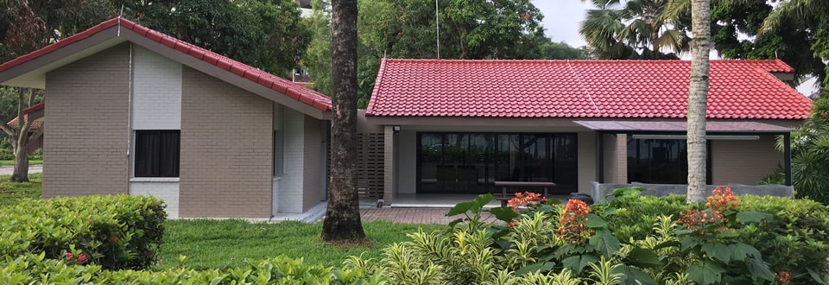
Where?
Aloha Loyang, Sea View Bungalow 1
159W Jalan Loyang Besar, Singapore 507020

Slide 4
How?
Getting to the campsite:
- Bus: 354 from Pasir Ris Interchange. Alight at the 4th bus stop 78251 (“Lighthouse"). Walk straight and turn left into Loyang place. Walk straight and Aloha Loyang will be on the right.
- Car: Exit TPE at Loyang Avenue and turn left onto Pasir Ris Drive 3. Drive another 1.6km and turn right onto Pasir Ris Rise. Then continue driving straight onto Jln Loyang Besar.

Slide 5
Shuttle Service
Campers are recommended to take the 3.25pm bus from Pasir Ris MRT should they wish to be at the campsite on time

Slide 6
Parking
Limited parking spaces are available on-site. Priority will be given to our speaker and camp service vehicles.
Ample paid parking spaces are available at public car-parks at Pasir Ris Car-park A and open car-park opposite the Downtown East, when the parking facilities at aloha Loyang are full.

Slide 7
Map to the Campsite

Slide 8
Chalet Layout

Slide 9
Speakers and speech timings
Speech 1: Basis/Standard of Self Examination Tuesday, December 19, 8pm Speaker: Rev. Andy Lanning Pastor, Covenant Evangelical Reformed Church | Speech 2 : Contentment Wednesday, December 20, 10am Speaker: Elder Lim Seow Thong Elder, Covenant Evangelical Reformed Church
Speech 3 : Antithesis Wednesday, December 20, 8pm Speaker: Elder Lee Kong Wee Elder, Covenant Evangelical Reformed Church | Speech 4: Love for church Thursday, December 21, 10am Speaker: Elder Leong Fai Chong ​Elder, Covenant Evangelical Reformed Church

Slide 10
Outing: Ninja Tag and Combat Archery
Wednesday, December 20
Bus leaves at 12pm
Will be back at the chalet by 6pm
Lunch will be at Kallang Wave Mall (at own cost)
Outing Venue: The Cage @ Kallang
Transport will be provide from the campsite to kallang wave mall and back to the chalet from the outing venue
Distance from Kallang wave mall to the cage will be aprox 1.3km.
Be in sports attire

Slide 11
Outing waver form
All campers attending the outing are required to fill up the waver form in the following link prior to the outing.
https://www.thefunempire.com/waiver
Failure to do so will not allow you to participate in the activity.

Slide 12
Things to bring
Sufficient clothing to last you through the camp (include one dark colored shirt sports clothes and your swimming gear** )
Small bag, water bottle and raincoat/umbrella - to take along during our outing
$10 cash or more – For lunch and if you want to grab a snack
Ez-link card with $10 value or more
Umbrella
Sports shoes
Sleeping bag
Toiletries
Medication, if you use any
* we don't recommend that you bring your PS4, pet, fridge, or the like. You should also leave all electronic gaming devices at home.
** If you like to make use of the AWESOME facilities during the free time.

Slide 13
Psalters
We will not be providing any hardcopy psalters so please be sure that you have the Psalter app downloaded into your phone.
Available on IOS and Andriod.

Slide 14
Key People
Campmaster: Kuang
Vice Campmaster: Noelene
Food IC: Given
Please inform the food IC if you have any:
1) Dietary restrictions
2) Addition/cancellation of registered meals (for part-time
campers)
Unfortunately, we will not be able to entertain requests for
special meal orders arising out of personal dietary preferences.**

Slide 15
Lastly
For more info, please visit the camp website at
https://ckckscamp.weebly.com/
Any questions?

